Slide 1
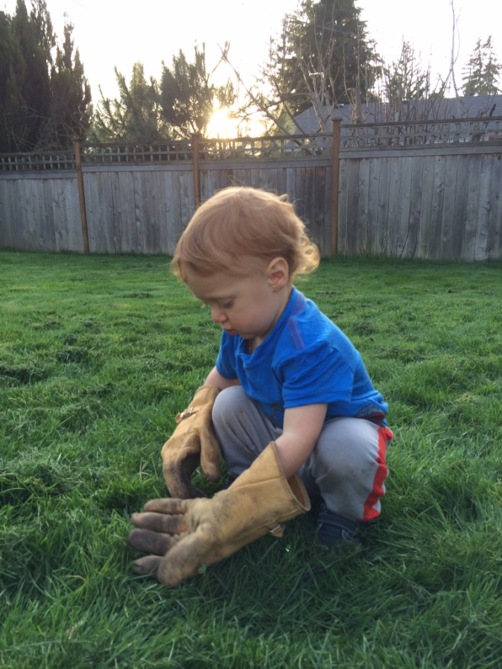
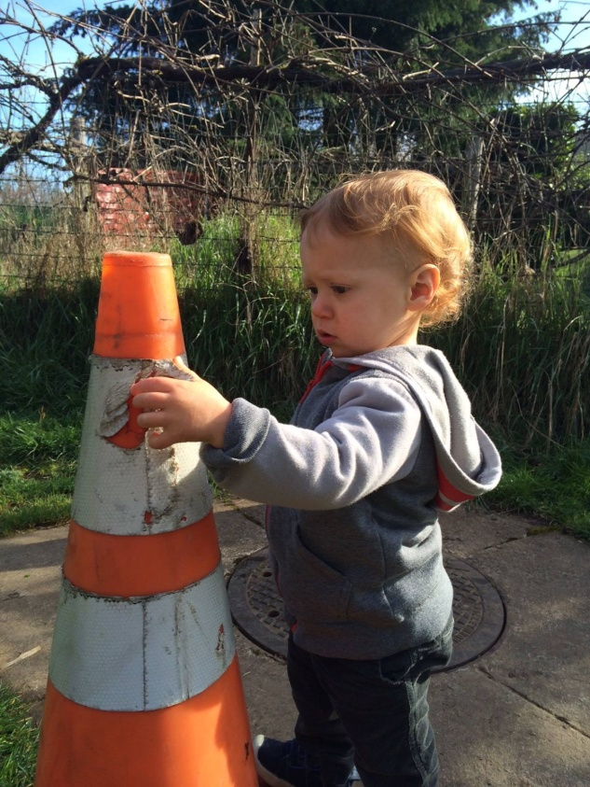
Safety Discussion
As told by Bob Lewis
February 2015
Elijah say check reflectivity on cones and barrels and wear your gloves!

Slide 2
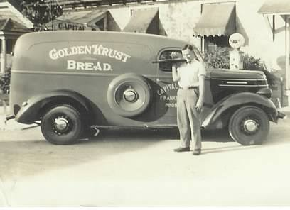
Herbert Sorg Lewis Born September 9, 1913 in Franklin County
Graduated 1931 from Frankfort High School. Attended UK for one year and then went to work in family bakery.
Herb was drafted into Air Force in 1943 and served as navigation instructor. He married Eloise Wood on January 3, 1946. He returned from WWII and went back to work in bakery.
Herb was father of 4, Jean, Sara, Bob & Anne.
.
.

Slide 3
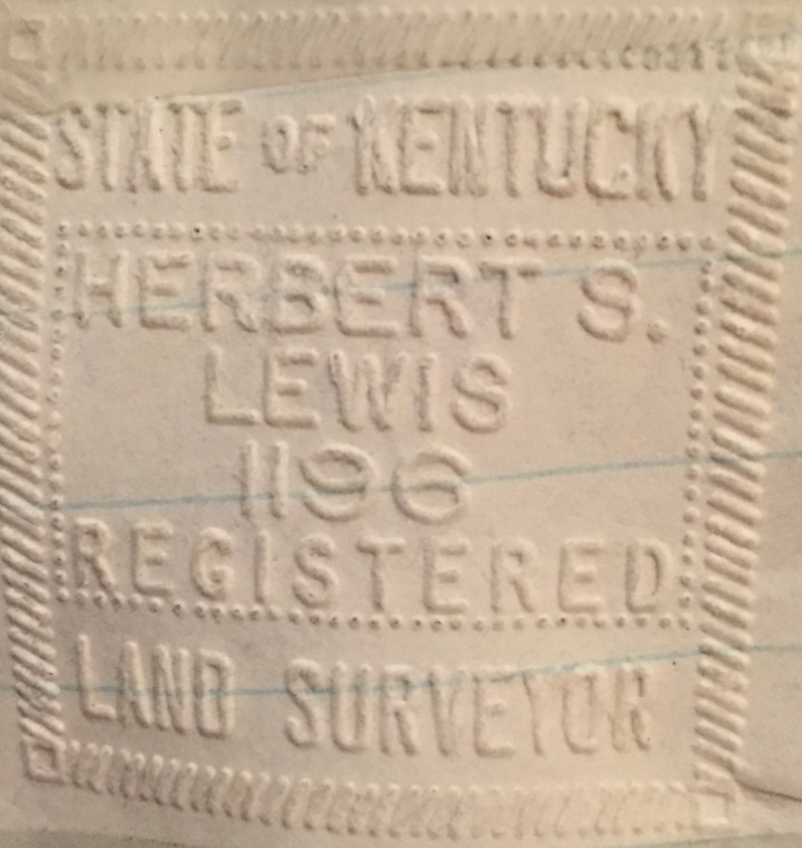
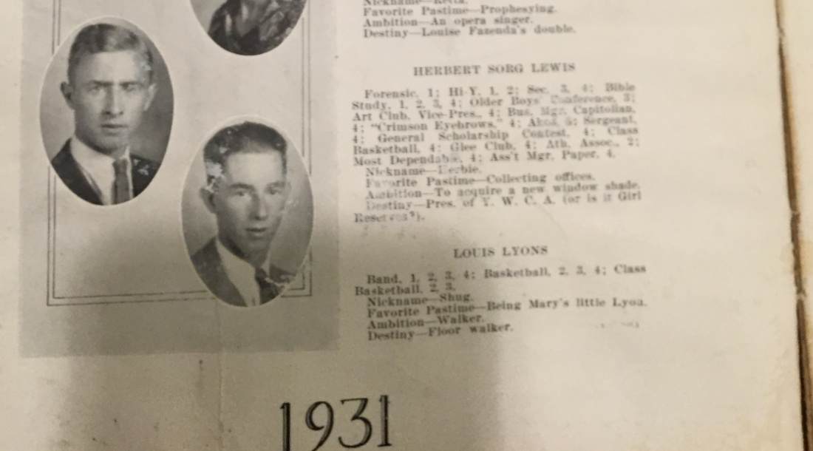
After closing the bakery in 1958, Herb first worked for City of Frankfort and then got hired by then KDOH Division of Planning, afterward transferred to KDH Franklin County Resident’s Crew working on I-64. He successfully passed the Highway Engineer’s Professional License test and Land Surveyor’s Test.
.

Slide 4
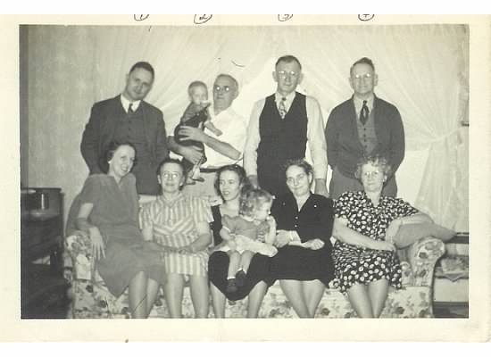
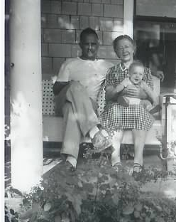
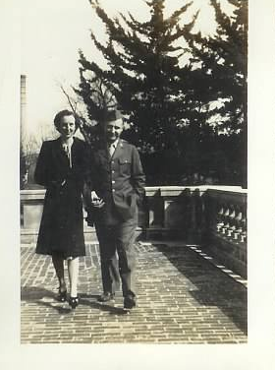
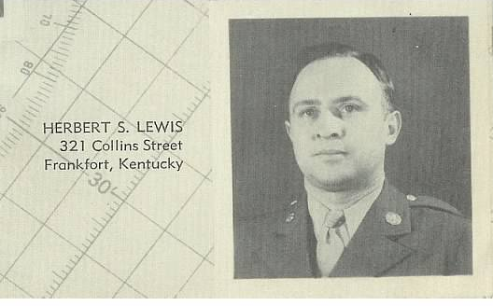

Slide 5
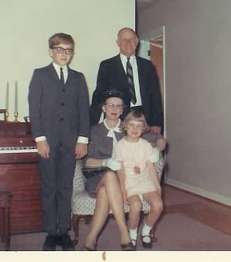
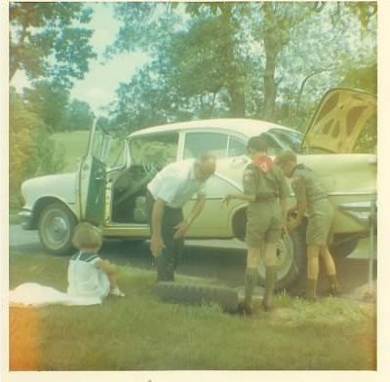
He was killed on job August 31, 1968 while working on Watterson Expressway bridge overlay project. Left Eloise widowed at age 50 with 8 year old Anne, 14 year old Bob, 20 year old Sara and 22 year old Jean. Additionally survived by grandson Reid age 4.

Slide 6
He was in spirit but was not able to physically attend just a brief life events after this date.
My sisters' Sara first wedding in 1969 and or second wedding in 1974
Her graduation from Pharmacy School in 1971
My graduation from Engineering School at UK in 1976.
My wedding in 1977
His first granddaughter Jessica in 1977
My nephew David born in 1980
My oldest daughter Katie born in 1981
My youngest sister Anne graduating from UK Pharmacy school in 1983.
My youngest daughter Rebecca born in 1984
My youngest sister’s wedding in 1986
My nephew Reid’s graduation from UK College on Engineering in 1991
My youngest nephew Christian born in 1994
My nephew Reid’s wedding in 1995.
His younger brother Henry passing in 1998
My niece Jessica graduation from Miami of Ohio in 1999
My nephew & Oldest Daughter’s college graduation in 2003.
My youngest daughter Rebecca’s graduation from UK in 2006.
Great grandson Elijah born 2013. Herb would have been 100!

Slide 7
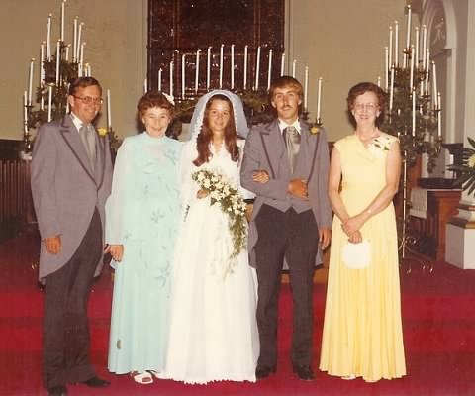
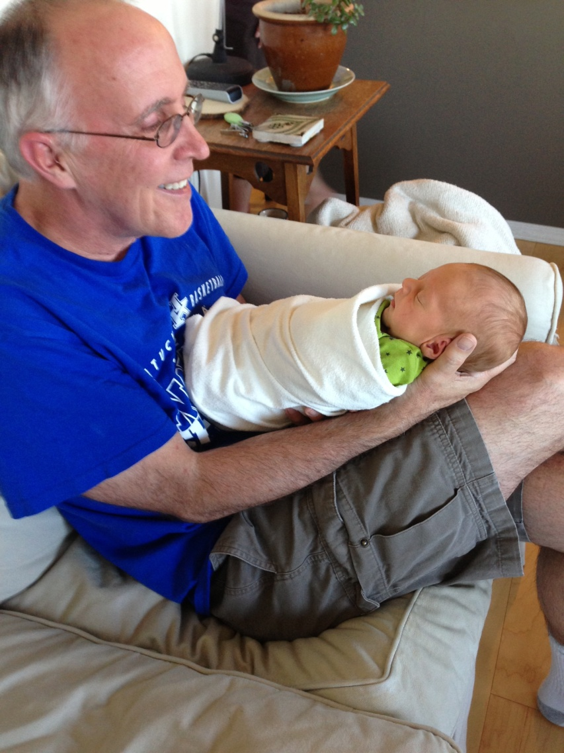
Elijah 2013
Wedding 1977

Slide 8
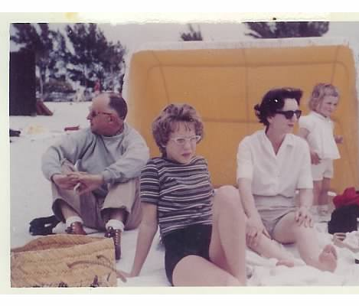
Not totally sure of situation as I was naïve freshman in High School. 1968 there was already significant traffic on 4 lane Watterson Expressway. This was a time when traffic cones were probably only device. No HI-Vis, not sure about hard hats. He did wear Boots and kaki pants, even on vacation to Florida!

Slide 9
We just need to remember your Family, your Friends and Co-Workers! You will be missed!
We need to think before getting out of vehicle on Maintenance activity or Construction project and put on the Hard Hat, Hi-Vis, Steel Toed Boots, Safety Glasses, Shin Guards. We need to NOT text, read e-mails, talk on phone while driving, take face book call from daughter, it only takes a second to have an accident.
It only takes less than a minute discombobulate a lifetime!

Slide 10
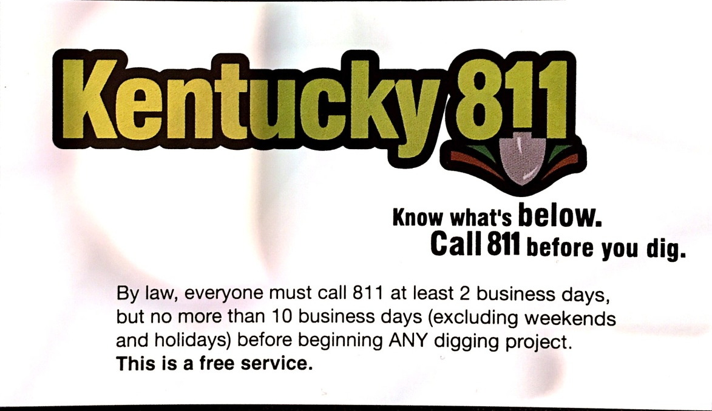
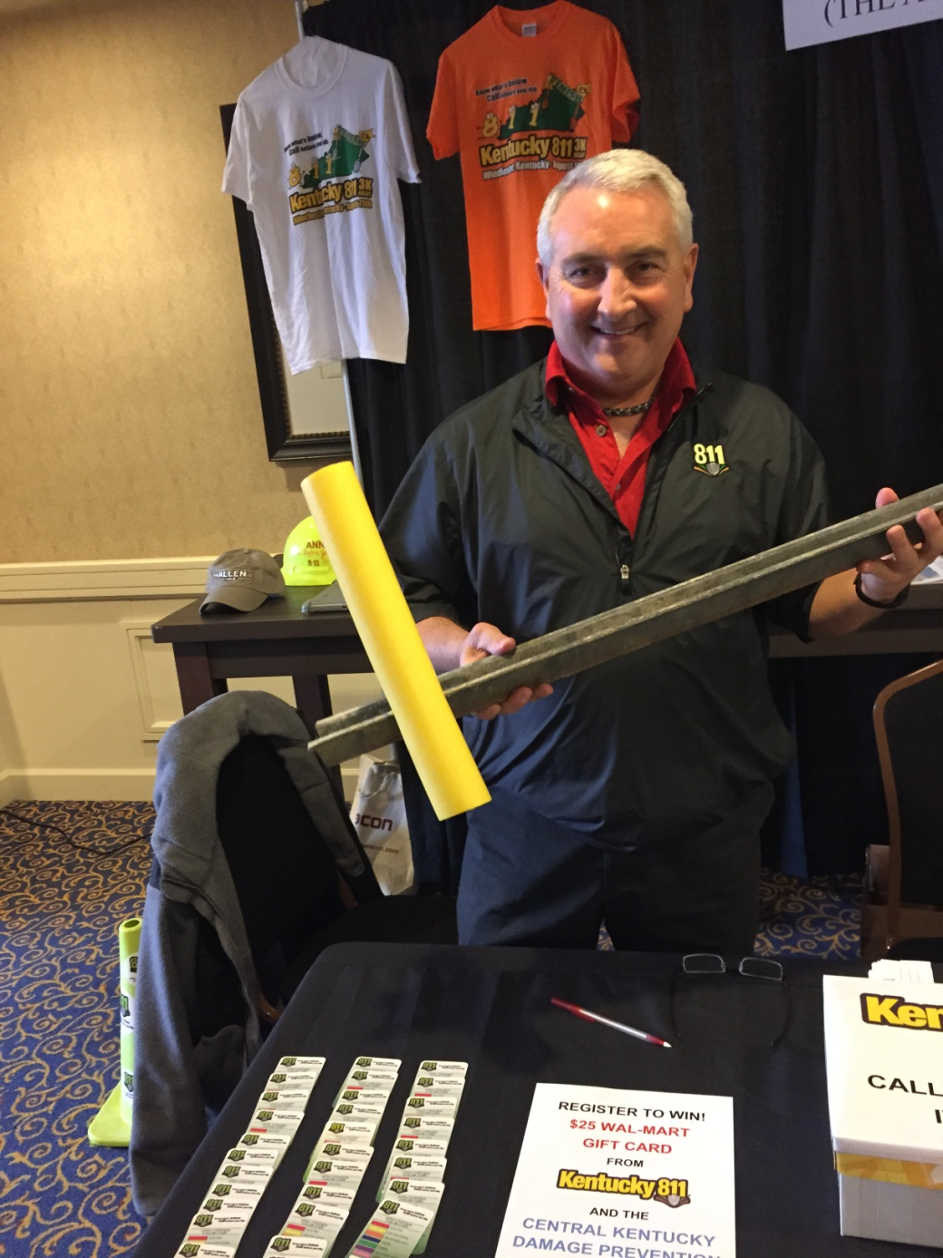
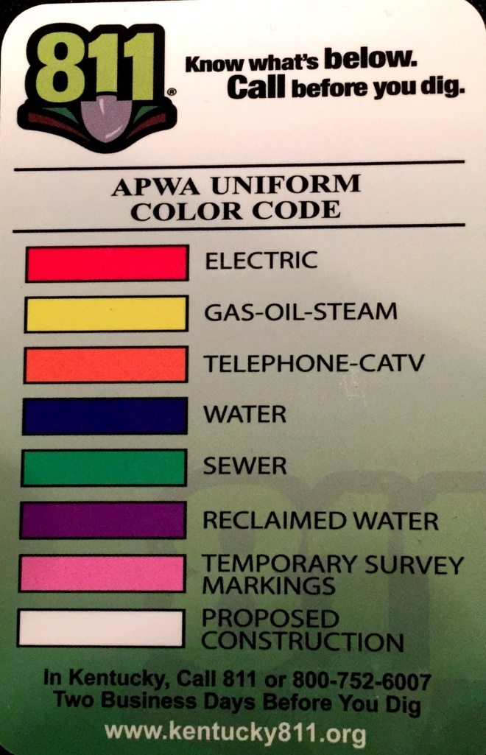
Sign post through a Gas Line.
YIKES, Please Call 811 first!!!

Slide 11
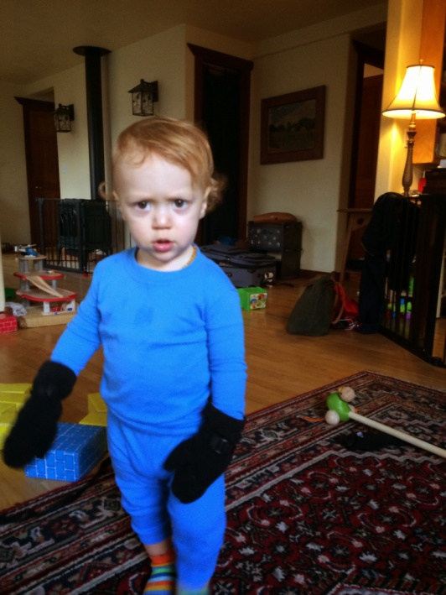
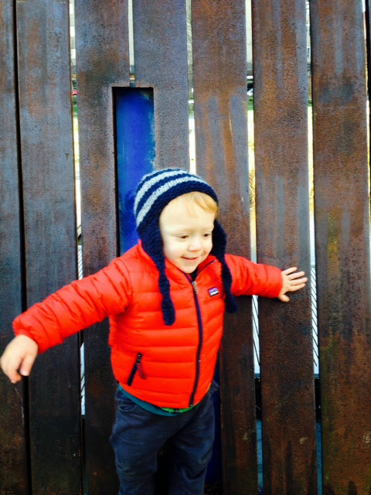
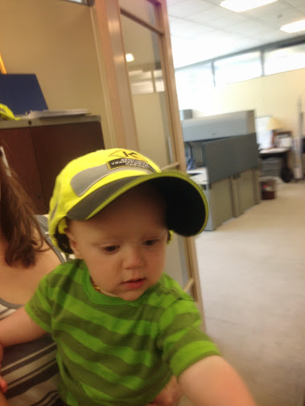
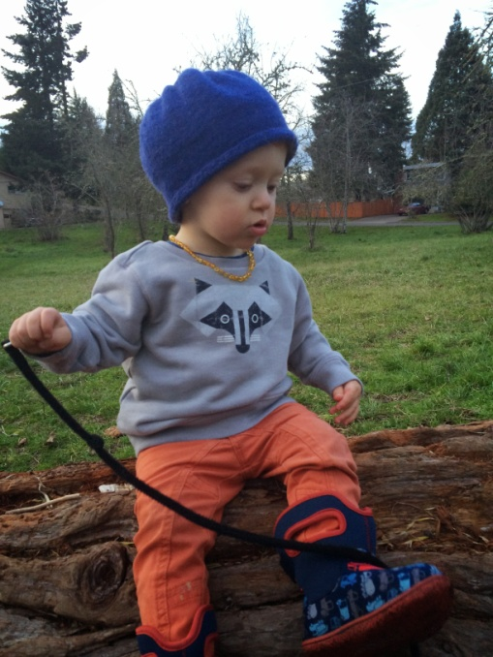
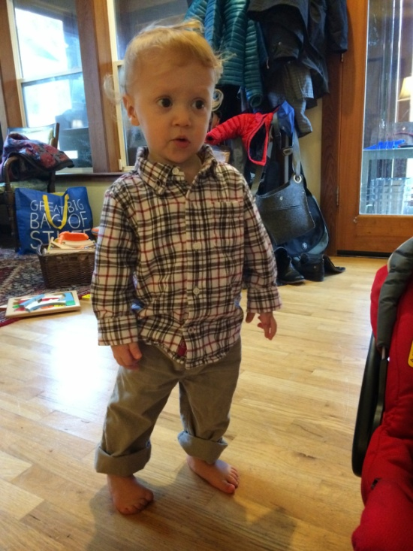
Elijah says:
Put you Hard Hat on your Hard Head!!

